Slide 1
Chapter 8. Classification: Basic Concepts
Classification: Basic Concepts
Decision Tree Induction
Bayes Classification Methods
Rule-Based Classification
Model Evaluation and Selection
Techniques to Improve Classification Accuracy: Ensemble Methods
Summary

Slide 2
Supervised vs. Unsupervised Learning
Relate to
expert systems
Supervised learning (classification)
  Supervision: The training data (observations, measurements, etc.) are accompanied by labels indicating the class of the observations
  New data is classified based on (classification models built from) the training set
Unsupervised learning (clustering)
  The class labels of training data is unknown
  Given a set of measurements, observations, etc. with the aim of establishing classes or clusters in the data

Slide 3
More Generally, Prediction:
Classification and Numeric Prediction
Classification
  Builds a classification model to predict categorical class labels (discrete or nominal)
    Based on a training set with class values (class labels)
  Uses the model to classify new data
Numeric Prediction
  Builds a model to predict continuous-valued attribute, i.e., predicts credit scores or intensity or direction of cyclones
Typical applications
  Credit/loan approval/denial
  Medical diagnosis: is a tissue cancerous or benign?
  Fraud detection: is a transaction fraudulent?
  Web page categorization: which category it belongs to

Slide 4
Classification—A Two-Step Process
Model construction: model describes the predetermined classes
  Each tuple/sample is assumed to belong to a predefined class, as specified by the class label attribute
  The set of tuples used for model construction is the training set
  The model is represented in some given form, e.g. classification rules, decision trees, or mathematical formulae, etc
Model usage: for classifying future objects
  Estimate accuracy of the model
    A test sample is correctly classified: its known label = the classified result from the model
    Accuracy rate is the percentage of test set samples that are correctly classified by the model
      Test set should be independent of the training set
Note: If the test set is used to select models among several models, it is called validation (test) set
Vs one tuple
belongs to
multiple classes

Slide 5



Process (1): Model Construction
Classification
Algorithms
Training
Data
Classifier
(Model)
IF rank = ‘professor’
OR years > 6
THEN tenured = ‘yes’

Slide 6




Process (2): Using the Model in Prediction
Classifier
Validation Test Data
Unseen Data
(Jeff, Professor, 4)
Tenured?

Slide 7
Nearest Neighbor Based Classification
Also called instance based learning
Algorithm (k=1)
  Given a new instance x,
  Find its nearest neighbor <x’,y’> in the training data
  Return y’ as the class of x
Distance measures
  Normalization!?
Some interesting questions
  What’s the time complexity?
  Does it find any knowledge pattern or model?
Related to “table lookup
based classifier”
Data Mining – Classification
G Dong
Notes:
An extension of table lookup?

Slide 8
Example of KNN (K-Nearest Neighbors)
A1 | A2 | A3 | C
1 | 2 | 1 | 1
0 | 0 | 1 | 1
2 | 1 | 2 | 2
1 | 2 | 2 | 2
0 | 1 | 2 | 1
2 | 2 | 2 | 2
For k=1: What is the class of (1,2,1)?
How about (2,1,1)?
What if k=3?
Dealing with noise – k-nearest neighbor
  Use more than 1 neighbor
  How many neighbors?
  Can use weighted nearest neighbors (e.g. weight = inverse of distance)
Data Mining – Classification
G Dong
Notes:
(2,1,1): nearest neighbor is (2,1,2), so its class is predicted to be 2.

Slide 9

Decision Tree Induction
D
Training data set example: Buys_computer
The data set follows an example of Quinlan (Playing Tennis)
A decision tree:
-->
age?
<=30
overcast
>40
31..40
student?
yes
credit rating?
# of possible trees is very large
no
yes
excellent
fair
no
yes
no
yes
Check correctness of
predictions on tuples in D

Slide 10
The ID3 Algorithm for Decision Tree Induction
Basic algorithm it is a greedy algorithm
  Tree is constructed in a top-down recursive divide-and-conquer manner
  At start, all the training examples are at the root
  Attributes are categorical (if continuous-valued, they are discretized in advance, for this algorithm)
  Set of examples is partitioned recursively (and assigned to the children nodes) based on selected attributes/conditions for nodes
  Test attributes are selected on the basis of a heuristic or statistical measure (i.e., information gain)
Conditions for stopping partitioning (at a node)
  All samples for the node belong to the same class C [C is the node’s label]
  There are no remaining attributes for further partitioning at the node [use majority voting to determine node’s class label]
  There are no samples at the node [how to choose class label?]

Slide 11



Attribute Selection Measure: Information Gain (ID3/C4.5)
At each node, select the attribute with the highest information gain
Let p_{i} be the probability that an arbitrary tuple in D belongs to class C_{i}, estimated by |C_{i, D}|/|D|
Expected information (entropy) for D:
Information after using A to split D into v partitions using the v A-values:
Information gained by branching on attribute A
Info: Entropy
purity, purity gain
If v=2: binary tree
Notes:
I : the expected information needed to classify a given sample
E (entropy) : expected information based on the partitioning into subsets by A

Slide 12






Attribute Selection at the Root: Information Gain
Class P: buys_computer = “yes”
Class N: buys_computer = “no”
means “age <=30” has 5 out of 14 samples, with 2 yes’es and 3 no’s.
Similarly,
Go back to slide 9 discuss
training data for children nodes
Notes:
Income=high: 2yes 2no; income=med: 4yes, 2no; income=low: 3yes, 1no

Slide 13
Computing Information-Gain for Continuous-Valued Attributes
Suppose attribute A is a continuous-valued attribute
Must determine the best split point for A
  Sort the A values in increasing order
  Typically, the midpoint between each pair of distinct adjacent values is considered as a possible split point
    (a_{i}+a_{i+1})/2 is the midpoint between two consecutive values of a_{i} & a_{i+1}
  The point with minimum expected information (equivalently: maximum info gain) is selected as the split-point for A
Split using A: D1 is the set of tuples in D satisfying A ≤ split-point, and D2 is the set of tuples in D satisfying A > split-point
We actually split D using the best attribute (the one with largest IG)

Slide 14

Gain Ratio for Attribute Selection (C4.5)
Information gain measure is biased towards attributes with a large number of values
C4.5 (a successor of ID3) uses gain ratio (applying normalization to information gain) to overcome this problem
  GainRatio(A) = Gain(A)/SplitInfo(A)
Ex.
  gain_ratio(income) = 0.029/1.557 = 0.019
The attribute with the maximum gain ratio is selected as the splitting attribute
What if |D1|=…=|Dr|?

Slide 15



Gini Index (CART, IBM IntelligentMiner)
If a data set D contains examples from n classes, gini index, gini(D) is defined as
where p_{j} is the relative frequency of class j in D
If a data set D is split on A into two subsets D₁ and D₂, the gini index gini_{A}(D) for the split is
Reduction in Impurity:
The attribute provides the smallest gini_{A}(D) (or the largest reduction in impurity) is chosen to split the node
Gini is quite similar to entropy, at least for 2 class problems (next slide)

Slide 16
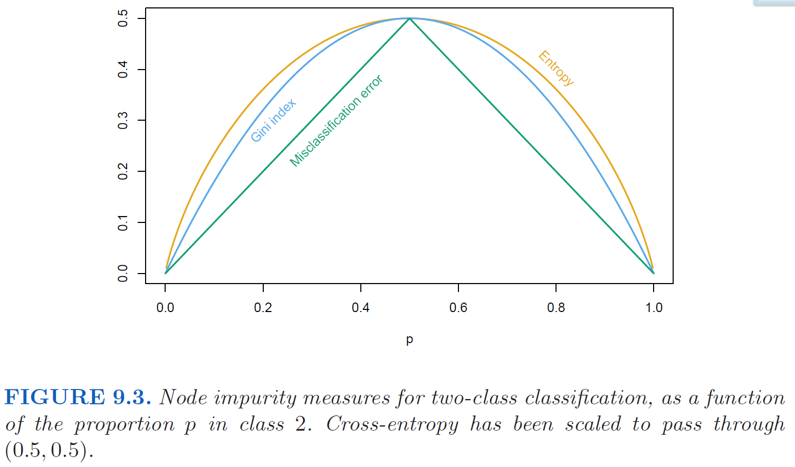
Node Impurity Measures: Entropy, Gini
Source: Hastie, Tibshirani and Friedman
“The Elements of Statistical Learning”, 2nd ed. Springer.

Slide 17
Comparing Attribute Selection Measures
The three measures, in general, return good results but
  Information gain:
    tends to favor attributes with many values
  Gain ratio:
    tends to favor unbalanced splits in which one partition is much smaller than the others
  Gini index:
    tends to favor multivalued attributes
    has difficulty when # of classes is large
    tends to favor tests (split conditions) that result in equal-sized partitions and purity in both partitions

Slide 18
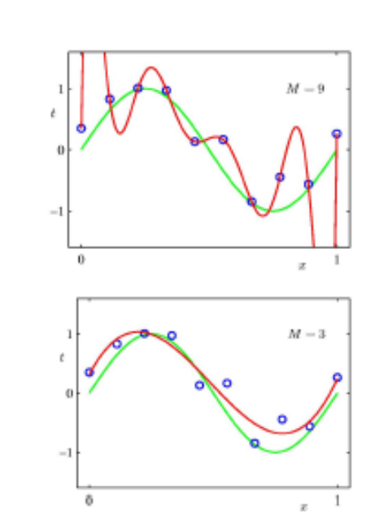
Overfitting
Overfitting: An induced model may overfit the training data
  e.g. Too many (long) branches in a decision tree; some may reflect anomalies due to noise or outliers
As a result, poor accuracy for unseen samples
More generally, a model overfits if it uses too much details in training data. Overfitting models typically do worse than simpler competing models on new data
The red curve at the top has degree 9, and the red curve at the bottom has degree 3.
If they have nearly identical accuracy, then the bottom one is better.
If the top one has bigger drop in accuracy from training to test data, then the bottom one is better.

Slide 19
Avoiding Overfitting; Tree Pruning
Two approaches to avoid overfitting for decision trees
  Prepruning: Halt tree construction early ̵ do not split a node if the split would result in some goodness measure falling below a threshold
    Difficult to choose an appropriate threshold
  Postpruning: Remove branches from a “fully grown” tree—get a sequence of progressively pruned trees
    Use a set of data different from the training data to decide which is the “best pruned tree”
Can also prune the rules associated with the tree
Will discuss how to get such rules from a tree later

Slide 20
Occam’s razor
Occam’s razor, or the law of parsimony: When presented with competing hypotheses (models) that make the same predictions, one should select the model with the fewest assumptions (or parameters).
Not meant for choosing b/w hypotheses (models) that make different predictions.
Occam: A philosopher who lived during 1287–1347.

Slide 21
Enhancements to Basic Decision Tree Induction
Allow for continuous-valued attributes
  Dynamically find split values for attributes to partition the continuous attribute values into several intervals [e.g. C4.5]
Handle missing attribute values
  Assign the most common value of the attribute
  Assign probability to each of the possible values
Attribute construction
  Create new attributes based on existing ones
  Helps with reducing fragmentation, repetition, and replication

Slide 22
Why is decision tree induction popular?
  model is easy to understand – highly interpretable
  relatively fast learning speed (compared against other classification methods)
  convertible to simple & easy to understand classification rules
  tree building can use SQL queries to access databases
  classification accuracy is not too bad

Slide 23
Classification in Large Databases
Scalability: Building classification models for datasets with millions of examples & hundreds of attributes with reasonable speed
RainForest (VLDB’98 — Gehrke, Ramakrishnan & Ganti)
  Builds and uses an AVC-list (AVC: attribute, value, class label)

Slide 24
AVC of Rainforest
It considers the scalability aspects in the tree building process.
It builds/uses an AVC-list: AVC (Attribute, Value, Class_label)
+ AVC allows efficient incremental computation
AVC-set on Age
AVC-set on income
Age | Buy_Computer
 | yes | no
<=30 | 2 | 3
31..40 | 4 | 0
>40 | 3 | 2
income | Buy_Computer
 | yes | no
high | 2 | 2
medium | 4 | 2
low | 3 | 1
Training Examples
AVC-set on
credit_rating
AVC-set on Student
student | Buy_Computer
 | yes | no
yes | 6 | 1
no | 3 | 4
Credit rating | Buy_Computer
 | yes | no
fair | 6 | 2
excellent | 3 | 3

Slide 25
Bayesian Classification
A statistical classifier: performs probabilistic prediction, i.e., predicts class membership probabilities
Foundation: Based on Bayes’ Theorem.
Performance: A simple Bayesian classifier, naïve Bayesian classifier, has comparable performance with decision tree and some neural network classifiers [sometimes, slightly worse]
An interpretable model type
Incremental: Each new training example can be used to modify/improve an existing Bayesian classifier; prior knowledge can be combined with newly observed data
Standard: Bayesian methods can provide a standard of classification against which other methods can be measured
Thomas Bayes: 1701 – 1761.
Notes:
Hypothesis: model

Slide 26
Bayes’ Theorem: Basics
Let X be a data sample (“evidence”); its class label is unknown
Let H be the hypothesis that X belongs to class C
Classification aims to determine P(H|X) (posteriori probability), the probability that the hypothesis is true given the observed data sample X
P(H) (prior probability), the initial probability of H
  E.g., X will buy computer, regardless of age, income, …
P(X): probability that sample data X is observed
P(X|H) (likelihood), the probability of observing the sample X, given that the hypothesis H holds
  E.g., Given that X will buy computer, the prob. that X is 31..40, medium income

Slide 27

Bayes’ Theorem
Given data instance X, posteriori probability of a hypothesis H, P(H|X), follows Bayes’ theorem
Informally, this can be written as
  posteriori = likelihood x prior/evidence
Predicts “X belongs to C_{i}” iff the probability P(C_{i}|X) is the highest among all the P(C_{j}|X) for all the j=1..k classes
Practical difficulty: require initial knowledge of many probabilities, requiring huge amount of data to estimate them and significant computational cost

Slide 28
Example: Using Bayes Theorem
For simplicity, assume we only have two attributes: “age” and the class.
An instance of the theorem:
P(buys_computer = “yes”| age = “<=30”)
= P(age = “<=30”| buys_computer = “yes”) * P(buys_computer = “yes”) / P(age = “<=30”)
= 2/9 * 9/14 / 5/14 = 2/5
X is 1-D here
Training Examples
X = (age = “<=30”)
P(buys_computer = “yes”) = 9/14
P(age = “<=30” | buys_computer = “yes”) = 2/9
P(age = “<=30”) = 5/14

Slide 29


Using Bayes Theorem to Classify
Let D be a training set of tuples and their associated class labels, and each tuple is represented by an n-D attribute vector X = (x₁, x₂, …, x_{n})
Suppose there are m classes C₁, C₂, …, C_{m}.
Classification: determine the C_{i} with the maximum posteriori, i.e., the maximal P(C_{i}|X)
We can use Bayes’ theorem
Since P(X) is constant for all classes C₁, C₂, …, C_{m}, we only
  need to maximize
Simplification 1

Slide 30


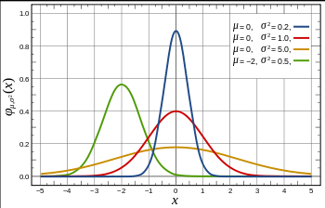
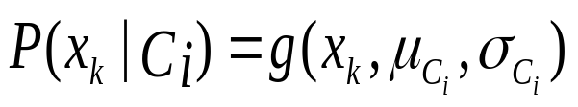
Naïve Bayes Classifier (NBC)
Simplification 2
NBC uses a simplifying assumption: attributes are conditionally independent (i.e., no dependence relation between attributes given class):
This greatly reduces the computation cost/complexity (& amount of needed training data): Only counts the values in classes
If A_{k} is categorical, P(x_{k}|C_{i}) is estimated as the # of tuples in C_{i} having value x_{k} for A_{k} divided by |C_{i, D}| (# of tuples of C_{i} in D)
If A_{k} is continuous-valued, P(x_{k}|C_{i}) is usually computed based on Gaussian distribution with a mean μ and standard deviation σ
  and P(x_{k}|C_{i}) is

Slide 31

Naïve Bayes Classifier: Training Dataset
Class:
C1:buys_computer = ‘yes’
C2:buys_computer = ‘no’
Data instance to be classified:
X = (age <=30,
Income = medium,
Student = yes
Credit_rating = Fair)
Next slide gives part of the NBC model for classifying X. The full model has 22 probabilities (2 + 3*2 + 3*2 + 2*2 + 2+2)

Slide 32
Naïve Bayes Classifier: An Example
P(C_{i}): P(buys_computer = “yes”) = 9/14 = 0.643
P(buys_computer = “no”) = 5/14= 0.357
Compute P(X|C_{i}) for each class
  P(age = “<=30” | buys_computer = “yes”) = 2/9 = 0.222
  P(age = “<= 30” | buys_computer = “no”) = 3/5 = 0.6
  P(income = “medium” | buys_computer = “yes”) = 4/9 = 0.444
  P(income = “medium” | buys_computer = “no”) = 2/5 = 0.4
  P(student = “yes” | buys_computer = “yes) = 6/9 = 0.667
  P(student = “yes” | buys_computer = “no”) = 1/5 = 0.2
  P(credit_rating = “fair” | buys_computer = “yes”) = 6/9 = 0.667
  P(credit_rating = “fair” | buys_computer = “no”) = 2/5 = 0.4
X = (age <= 30 , income = medium, student = yes, credit_rating = fair)
P(X|C_{i}) : P(X|buys_computer = “yes”) = 0.222 x 0.444 x 0.667 x 0.667 = 0.044
P(X|buys_computer = “no”) = 0.6 x 0.4 x 0.2 x 0.4 = 0.019
P(X|C_{i})*P(C_{i}) : P(X|buys_computer = “yes”) * P(buys_computer = “yes”) = 0.028
P(X|buys_computer = “no”) * P(buys_computer = “no”) = 0.007
Therefore, the NBC predicts “X belongs to the class (“buys_computer = yes”)”
#Values: 2Class, 3Age, 3Income, 2Student, 2Credit_rating

Slide 33

Avoiding the Zero-Probability Problem
Naïve Bayesian classification requires each conditional prob. to be non-zero. Otherwise, some predicted prob. can be zero causing poor classification decisions
Ex. Suppose a dataset with 1000 tuples, income=low (0), income= medium (990), and income = high (10)
Use Laplacian correction (or Laplacian estimator)
  Add 1 to each dividend and add # of counters to each divisor
    Prob(income = low) = 1/1003=(1+0)/(1000+3)
    Prob(income = medium) = 991/1003
    Prob(income = high) = 11/1003
  The “corrected” prob. estimates are close to their “uncorrected” counterparts and they will not be zero
Proportional
adjustment for all
Go back to
work out examples
also on next slide

Slide 34
Naïve Bayes Classifier with Laplacian Correction
P(C_{i}): P(buys_computer = “yes”) = (9+1)/(14+2) =10/16
P(buys_computer = “no”) = …
Compute P(X|C_{i}) for each class
  P(age = “<=30” | buys_computer = “yes”) = (2+1)/(9+3) = 3/12
  P(age = “<= 30” | buys_computer = “no”) =
  P(income = “medium” | buys_computer = “yes”) =
  P(income = “medium” | buys_computer = “no”) =
  P(student = “yes” | buys_computer = “yes) =
  P(student = “yes” | buys_computer = “no”) =
  P(credit_rating = “fair” | buys_computer = “yes”) =
  P(credit_rating = “fair” | buys_computer = “no”) =

Slide 35
Naïve Bayes Classifier: Comments
Advantages
  Easy to implement
  Good results obtained in many cases
Disadvantages
  Assuming class conditional independence
  In practice, dependencies exist among variables/attributes
    E.g., 1) patient’s age and height are correlated;
      2) If patient has fever then patient often coughs
    Dependencies among these cannot be modeled by Naïve Bayes Classifier
How to deal with these dependencies? Bayesian Belief Networks (Chapter 9)

Slide 36
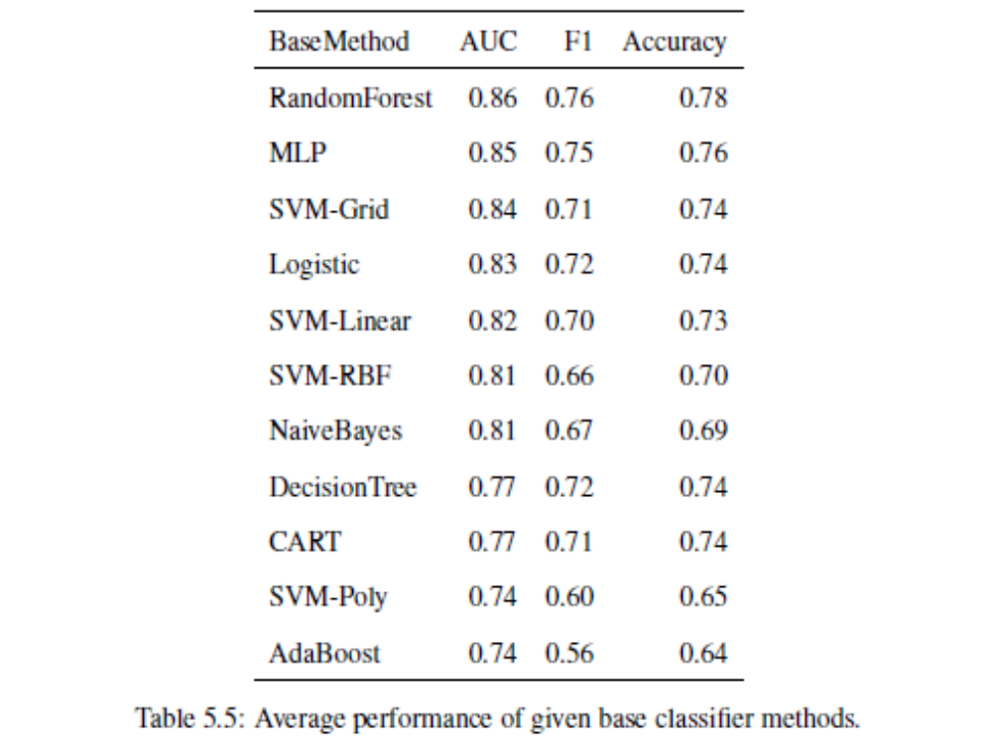
Performance of 11 classification
algorithms on 110 datasets
Accuracy:
percentage of test tuples
that are correctly classified
By Skapura and Dong

Slide 37
Chapter 8. Classification: Basic Concepts
Classification: Basic Concepts
Decision Tree Induction
Bayes Classification Methods
Rule-Based Classification
Model Evaluation and Selection
Techniques to Improve Classification Accuracy: Ensemble Methods
Summary

Slide 38
Using IF-THEN Rules or Emerging Patterns for Classification
Represent the knowledge in the form of IF-THEN rules (or emerging patterns)
  R: IF age = youth AND student = yes THEN buys_computer = yes
  Rule antecedent/precondition vs. rule consequent; LHS, RHS
Assessment of a rule: coverage and accuracy
  n_{covers} = # of tuples covered by R |mds(bodyOfR)|
  n_{correct} = # of tuples correctly classified by R
  coverage(R) = n_{covers} /|D| /* D: training data set */
  accuracy(R) = n_{correct} / n_{covers}
Rules or emerging patterns can be computed from decision trees (although only a very small subset of available patterns), using emerging pattern mining algorithms, or using rule induction methods.

Slide 39
Rule Extraction from a Decision Tree
age?
<=30
31..40
>40
Rules are easier to understand than large trees
One rule is created for each root-to-leaf path
Attribute-value pairs along a path form a conjunction, the leaf holds the predicted class
Rules from a decision tree are mutually exclusive and exhaustive …
student?
yes
credit rating?
no
yes
excellent
fair
no
yes
no
yes
Example: Rule extraction from the above decision tree
  IF age <=30 AND student = no THEN buys_computer = no
  IF age <=30 AND student = yes THEN buys_computer = yes
  IF 31 <= age <=40 THEN buys_computer = yes
  IF age >40 AND credit_rating = excellent THEN buys_computer = no
  IF age >40 AND credit_rating = fair THEN buys_computer = yes

Slide 40
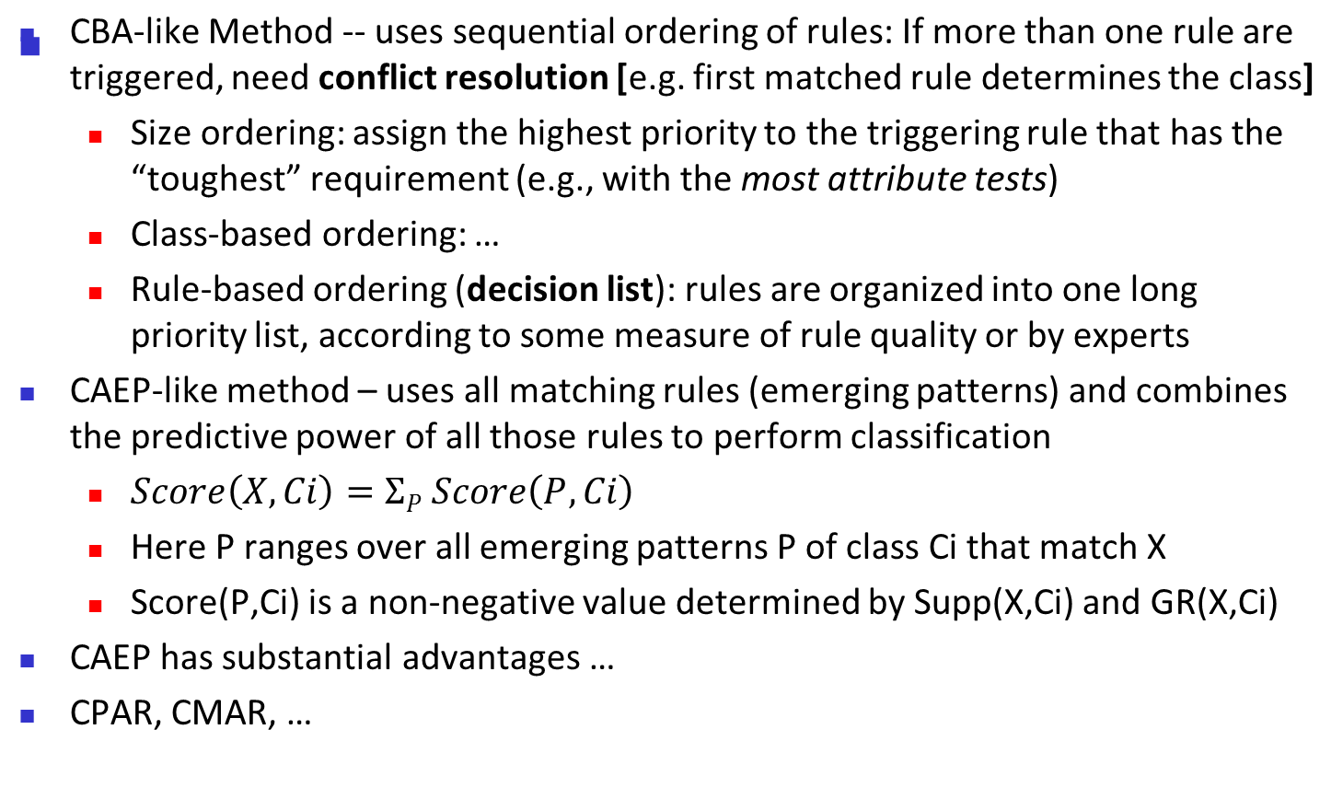
Using IF-THEN Rules for Classification
Liu et al 98
Dong et al 99
Han et al 2000s
Associative classifiers

Slide 41
Chapter 8. Classification: Basic Concepts
Classification: Basic Concepts
Decision Tree Induction
Bayes Classification Methods
Rule-Based Classification
Model Evaluation and Selection
Techniques to Improve Classification Accuracy: Ensemble Methods
Summary

Slide 42
Model Evaluation and Selection
Evaluation metrics: How can we measure accuracy? What metrics to consider?
We typically use validation/test set of class-labeled tuples instead of training set when assessing accuracy
Methods for estimating a classifier’s accuracy:
  Holdout method, random subsampling
  Cross-validation
  Bootstrap
Comparing classifiers:
  Confidence intervals
  Cost-benefit analysis and ROC Curves

Slide 43
Classifier Evaluation Metrics: Confusion Matrix
Confusion Matrix:
Predicted Class
 | C₁ | ¬ C₁
C₁ | True Positives (TP) | False Negatives (FN)
¬ C₁ | False Positives (FP) | True Negatives (TN)
Actual Class
Example of Confusion Matrix:
Actual class\Predicted class | buy_computer = yes | buy_computer = no | Total
buy_computer = yes | 6954 | 46 | 7000
buy_computer = no | 412 | 2588 | 3000
Total | 7366 | 2634 | 10000
Given m classes, entry CM_{i,j} in the confusion matrix indicates the # of tuples in class i that were labeled by the classifier as class j
May have extra rows/columns to provide totals
Number of rows/columns depend on the # of classes: 3X3 matrix for 3 classes

Slide 44
Classifier Evaluation Metrics: Accuracy, Error Rate, Sensitivity and Specificity
A\P | C | ¬C
C | TP | FN | P
¬C | FP | TN | N
 | P’ | N’ | All
For Imbalanced Classification:
  One class may be rare, e.g. fraud, or HIV-positive
  Significant majority = the negative class; minority = the positive class
  Sensitivity: True Positive recognition rate
    Sensitivity = TP/P
  Specificity: True Negative recognition rate
    Specificity = TN/N
Classifier Accuracy, aka recognition rate: percentage of test tuples that are correctly classified
  Accuracy = (TP + TN)/All
Error rate: 1 – accuracy, or
  Error rate = (FP + FN)/All

Slide 45




Classifier Evaluation Metrics:
Precision and Recall, and F-measures
Precision: exactness – % of tuples labeled as positive by the classifier that are actually positive (TP/P’)
Recall: completeness – % of positive tuples labeled as positive by the classifier (TP/P)
Perfect score is 1.0
Inverse relationship between precision & recall
F measure (F₁ or F-score): “harmonic” mean of precision & recall:
F_{ß}: weighted “harmonic” mean of precision and recall
  assigns ß times as much weight to recall as to precision
Recall=Sensitivity
Notes:
https://en.wikipedia.org/wiki/Harmonic_mean

Slide 46
Classifier Evaluation Metrics: Example
Actual Class\Predicted class | cancer = yes | cancer = no | Total | Recognition(%)
cancer = yes | 90 | 210 | 300 | 30.00 (sensitivity)
cancer = no | 140 | 9560 | 9700 | 98.56 (specificity)
Total | 230 | 9770 | 10000 | 96.50 (accuracy)
  Precision = 90/230 = 39.13% Recall = 90/300 = 30.00%
A\P | C | ¬C
C | TP | FN | P
¬C | FP | TN | N
 | P’ | N’ | All

Slide 47
Evaluating Classifier Accuracy:
Holdout & Cross-Validation Methods
Holdout method
  Given data is randomly partitioned into two disjoint sets
    Training set (e.g., 2/3) for model construction
    Test set (e.g., 1/3) for accuracy estimation
  Random sampling: a variation of holdout
    Repeat holdout k times, accuracy = avg. of the accuracies obtained on the k holdout exps
Cross-validation (k-fold, where k = 10 is the most popular)
  Randomly partition the dataset D into k mutually exclusive subsets D₁,…,D_{k}, of approximately equal sizes
  At i-th iteration, use D_{i} as test set and the rest as training set (e.g k=3 …)
  *Stratified cross-validation*: folds are stratified so that class dist. in each D_{i} is approx. the same as that in the initial data
Leave-one-out: k folds CV where k = # of tuples, for small sized data

Slide 48

Evaluating Classifier Accuracy: Bootstrap
Bootstrap
  Works well with small data sets
  Samples the given training tuples uniformly with replacement
    i.e., each time a tuple is selected, it re-added to the training set and hence it is equally likely to be selected again
Several bootstrap methods, and a common one is .632 boostrap
  A data set with d tuples is sampled d times, with replacement, resulting in a training set of d samples. The data tuples that did not make it into the training set end up forming the test set. About 63.2% of the original data end up in the bootstrap, and the remaining 36.8% form the test set (since (1 – 1/d)^{d} ≈ e⁻¹ = 0.368)
  Repeat the sampling procedure k times, overall accuracy of the model:

Slide 49

Accuracy by AUC &
Model Selection via ROC Curves
ROC (Receiver Operating Characteristics) curves: for visual comparison of classification models
Originated from signal detection theory
Shows the trade-off between the true positive rate and the false positive rate
The area under the ROC curve (AUC) is a measure of the accuracy of the model
How: Rank the test tuples in decreasing order: the one that is most likely to belong to the positive class appears at the top of the list [assuming classifier gives all instances scores for pos class ]
The closer to the diagonal line (i.e., the closer the area is to 0.5), the less accurate is the model: useful for selecting models
Vertical axis: the true positive rate
Horizontal axis : the false positive rate
The plot also shows a diagonal line
A model with perfect accuracy will have an area under the curve (AUC) of 1.0
Notes:
Basically: for each object x, your classifier computes scores for each class, s1 and s2.
Uses s1-s2 to make classification. Sort the objects according to their s1-s2 values. Take each possible value v between 0 and 1 as cutoff for use as threshold for classification – s1-s2<=v ➔ class 2, s1-s2>v ➔ class 1. Compute the TP and FP for each v. Then you get the curve.

Slide 50
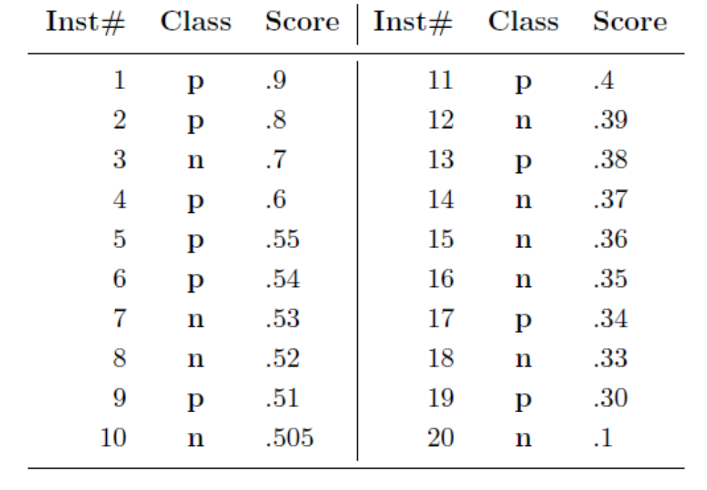

How to Compute the ROC Curve
Go thru all possible thresholds:
Picking 0.9 as threshold:
TP=1, FP=0, TN=10, FN=9
Picking 0.7 as threshold:
TP=2, FP=1, TN=9, FN=8
Picking 0.6 as threshold:
TP=3, FP=1, TN=9, FN=7
FP rate = FP/|P|
TPrate = TP/|P|
Given: Predicted score for instances belonging to the p class
How to convert two class probabilities into positive class scores
p n
O1: 0.5, 0.2
O2: 0.4, 0.3
O3: 0.3,0.3
O4: 0.2,0.4
Many ways, e.g. Prob(P)-Prob(N)
10 +cases, 10 -cases
ROC: FP-TP rates of all classifiers built using all possible thresholds

Slide 51
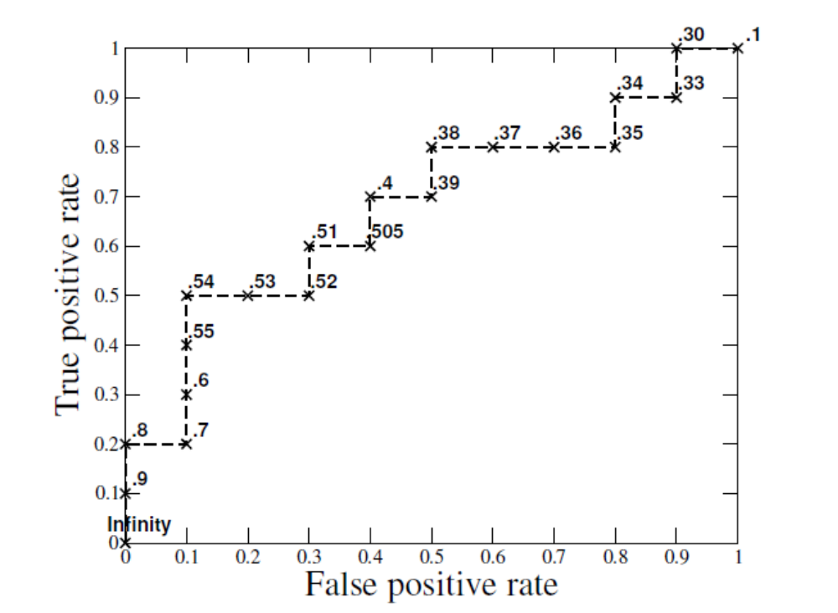
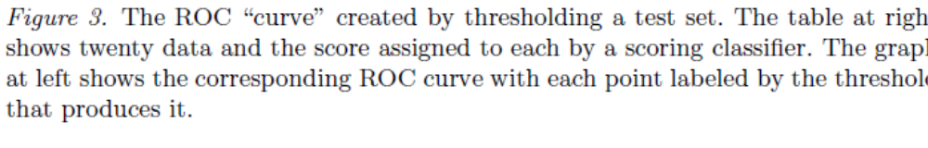
Each FPrate-TPrate
pair for one
threshold makes
a point in the
ROC curve
What is the AUC?

Slide 52


Estimating Confidence Intervals:
Classifier Models M₁ vs. M₂
skip in 1st pass
Suppose we have 2 classifiers, M₁ and M₂, which one is better?
Use 10-fold cross-validation to obtain and
These mean error rates are just estimates of error on the true population of future data cases
When it is the case that the small difference between the 2 error rates is due to chance (M1 and M2 are really the same)?
  Use a test of statistical significance
  Obtain confidence limits for our error estimates

Slide 53

Estimating Confidence Intervals:
Null Hypothesis
skip in 1st pass
Perform 10-fold cross-validation
Assume samples follow a t distribution with k–1 degrees of freedom (here, k=10)
Use t-test (or Student’s t-test)
Null Hypothesis: M₁ & M₂ are the same
If we can reject null hypothesis, then
  we conclude that the difference between M₁ & M₂ is statistically significant
  Chose model with lower error rate

Slide 54


Estimating Confidence Intervals: t-test
skip in 1st pass
If only 1 test set available: pairwise comparison
  For i^{th} round of 10-fold cross-validation, the same cross partitioning is used to obtain err(M₁)_{i} and err(M₂)_{i}
  Average over 10 rounds to get
  t-test computes t-statistic with k-1 degrees of freedom:
If two test sets available: use non-paired t-test
and
where
where
where k₁ & k₂ are # of cross-validation samples used for M₁ & M₂, resp.
Notes:
Corection: Non-paired t-test: t=(avg(err(M1)) – avg(err(M2))) / var(M1-M2)

Slide 55

Estimating Confidence Intervals:
Table for t-distribution
skip in 1st pass
Symmetric
Significance level, e.g., sig = 0.05 or 5% means M₁ & M₂ are significantly different for 95% of population
Confidence limit, z = sig/2

Slide 56
Estimating Confidence Intervals:
Statistical Significance
skip in 1st pass
Are M₁ & M₂ significantly different?
  Compute t. Select significance level (e.g. sig = 5%)
  Consult table for t-distribution: Find t value corresponding to k-1 degrees of freedom (here, 9)
  t-distribution is symmetric: typically upper % points of distribution shown → look up value for confidence limit z=sig/2 (here, 0.025)
  If t > z or t < -z, then t value lies in rejection region:
    Reject null hypothesis that says “error rates of M₁ & M₂ are same”
    Conclude: statistically significant difference between M₁ & M₂
  Otherwise, conclude that any difference is chance

Slide 57
Issues to Consider in Model Selection
Accuracy
  classifier accuracy for predicting class label
Speed
  time to construct the model (training time)
  time to use the model (classification/prediction time)
Robustness: handling noise and missing values
Scalability: efficiency with disk-resident databases
Interpretability
  Understandability of and insight provided by the model
Other measures, e.g., goodness of rules, such as decision tree size or compactness of classification rules

Slide 58
Chapter 8. Classification: Basic Concepts
Classification: Basic Concepts
Decision Tree Induction
Bayes Classification Methods
Rule-Based Classification
Model Evaluation and Selection
Techniques to Improve Classification Accuracy: Ensemble Methods
Summary
Perhaps this is the only “free lunch”
Feature engineering is another technique

Slide 59

Ensemble Methods: Increasing the Accuracy
Ensemble methods
  Use a combination of models to increase accuracy
  Combine a series of k learned models, M₁, M₂, …, M_{k}, with the aim of creating an improved model M*
Popular ensemble methods
  Bagging: averaging the prediction over a collection of classifiers
  Boosting: weighted vote with a collection of classifiers
  Heterogeneous ensemble: combining a set of heterogeneous classifiers

Slide 60
Bagging: Boostrap Aggregation
Analogy: Patient diagnosis based on multiple doctors’ majority vote
Training
  Given a set D of d tuples, at each iteration i, a training set D_{i} of d tuples is sampled with replacement from D (i.e., bootstrap)
  A classifier model M_{i} is learned independently for each training set D_{i}
Classification: classify an unknown sample X
  Each classifier M_{i} returns its class prediction
  The bagged classifier M* counts the votes for each class and assigns the class with the most votes to X
Prediction: can be applied to the prediction of continuous values by taking the average value of each prediction for a given test tuple
Accuracy
  Often significantly better than a single classifier derived from D
  For noise data: not considerably worse, more robust
  Proved to improve accuracy in prediction

Slide 61
Boosting (e.g. AdaBoost on next slide)
Analogy: Consult several doctors, based on a combination of weighted diagnoses—weight assigned based on the previous diagnosis accuracy. But the doctors were trained sequentially
How boosting works?
  Weights are assigned to each training tuple
  A series of k classifiers is iteratively learned
  After a classifier M_{i} is learned, the weights are updated to allow the subsequent classifier, M_{i+1}, to pay more attention to the training tuples that were misclassified by M_{i}
  The final M* combines the votes of each individual classifier M_{i}, where the weight of each classifier's vote is a function of M_{i}’s accuracy
Boosting algorithm can be extended for numeric prediction
Comparing with bagging: Boosting tends to have greater accuracy, but it also risks generating an overfitting model

Slide 62


Adaboost (Freund and Schapire, 1997)
Given a set of d class-labeled tuples, (X₁, y₁), …, (X_{d}, y_{d})
Initially, all the weights of tuples are set the same (1/d)
Generate k classifiers in k rounds. At round i,
  Tuples from D are sampled (with replacement) to form a training set D_{i} of the same size
  Each tuple’s chance of being selected is based on its weight
  A classification model M_{i} is derived from D_{i}
  Its error rate is calculated using D_{i} as a test set
  If a tuple is misclassified, its weight is increased, else it is decreased
    E.g. add/minus 1/d [how much can affect the result]
Define err(X_{j}) as the misclassification error of tuple X_{j} (=0 or 1). Classifier M_{i} error rate is the sum of the weights of the misclassified tuples:
The weight of classifier M_{i}’s vote is

Slide 63
Random Forest
Random Forest (Breiman 2001):
  Each classifier in the ensemble is a decision tree classifier and is generated using a random selection of attributes at each node to determine the split [may also sample the data for the node]
  During classification, each tree votes and the most popular class is returned
Two other methods to construct Random Forest:
  Forest-RI (random input selection): Randomly select, at each node, F attributes as candidates for selecting split attribute at the node. The CART methodology is used to grow the trees to maximum size
  Forest-RC (random linear combinations): Creates new attributes (or features) that are a linear combination of the existing attributes (reduces the correlation between individual classifiers)
Comparable in accuracy to Adaboost, but more robust to errors and outliers
Insensitive to the number of attributes selected for consideration at each split, and faster than bagging or boosting [should not be too few attributes]

Slide 64
Performance of 11 classification
algorithms on 110 datasets
Performance ranking
depends on the
datasets included
in the study
By Skapura and Dong

Slide 65
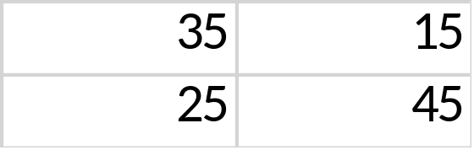
Diversity of Member Classifiers is Key for Selecting a Good Ensemble
Two criteria for selecting ensemble member classifiers:
  Each committee member is reasonably good
  Different committee members are diverse (with highly different classification behavior)
Define Nij for two classifiers M1 and M2 on data with two classes: Nij = number of data instances that are classified as class i by classifier M1 and classified as class j by classifier M2. Use these to measure agreement/diversity between M1 and M2
Highly diverse when non-diagonals are large

Slide 66
Classification of Class-Imbalanced Data Sets
IR
Class-imbalance problem: Positive examples are rare but negative ones are plenty, e.g., medical diagnosis, fraud, oil-spill, fault, etc.
Traditional methods assume a balanced distribution of classes and equal error costs: not suitable for class-imbalanced data
Typical methods for imbalanced data in 2-class classification:
  Oversampling: added sampling of data from positive class (some considered creating new positive instances using EPs)
  Under-sampling: randomly eliminate tuples from negative class
  SMOTE (Synthetic Minority Over-sampling Technique)
  Threshold-moving: moves the decision threshold, t, so that the rare class tuples are more likely classified as rare, and hence, less chance of costly false negative errors
  Ensemble techniques: Ensemble multiple classifiers introduced above
It is still difficult to do imbalanced classification on multiclass tasks

Slide 67
Recent Advances on Classification
Interpretability
Very large number of classes
Hierarchy of classes
Deep learning
…

Slide 68
Summary (I)
Classification is a form of data analysis that extracts models describing important data classes.
Effective and scalable methods have been developed for decision tree induction, Naive Bayesian classification, rule-based classification, and many other classification methods.
Evaluation metrics include: accuracy, sensitivity, specificity, precision, recall, F measure, and F_{ß} measure.
Stratified k-fold cross-validation is recommended for accuracy estimation. Bagging and boosting can be used to increase overall accuracy by learning and combining a series of individual models.

Slide 69
Summary (II)
Significance tests and ROC curves are useful for model selection.
There have been numerous comparisons of the different classification methods; the matter remains a research topic
No single method has been found to be superior over all others for all data sets
Issues such as accuracy, training time, robustness, scalability, and interpretability must be considered and can involve trade-offs, further complicating the quest for an overall superior method

Slide 70
Sampling with or without replacement
Replacement affects the calculation of probabilities (and make the population looks like infinite …)
EG (for former): What is the probability of drawing two aces from a standard deck of cards?
There are four aces and 52 cards total, so the probability of drawing one ace is 4/52. If we replace this card and draw again, then the probability is again 4/52. These events are independent, so we multiply the probabilities (4/52) x (4/52) = 1/169 ~= 0.592%.
If we do not replace the cards, the probability of drawing an ace on the first draw is still 4/52. For the second card, we assume that an ace has been already drawn. There are now three remaining out of a total of 51 cards. The probability of drawing two aces is (4/52) x (3/51) = 1/221, or about 0.425%.

